Slide 1
Flood prediction using machine learning
By
Akshay Ghatage(CMS1905)
Sandip Lengare(CMS1914)

Slide 2
Main aim -
Alert people of upcoming flood notification
Showing the flood trends by analyzing the rainfalls for previous years

Slide 3
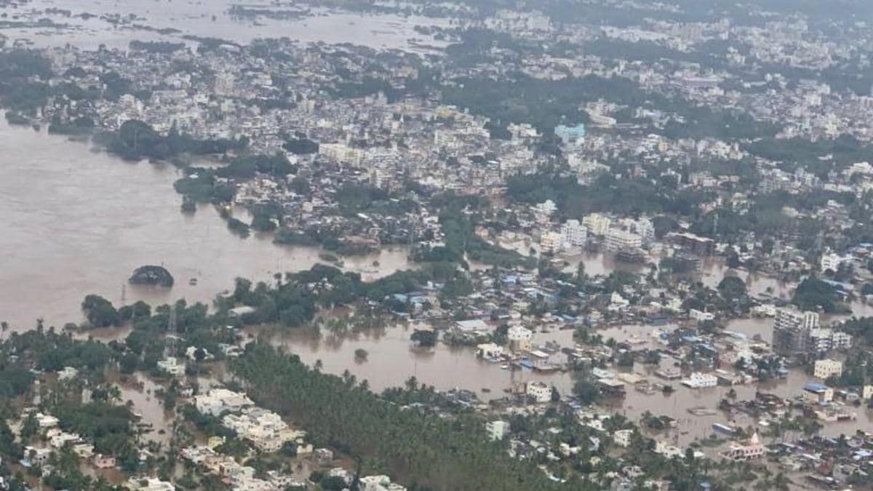
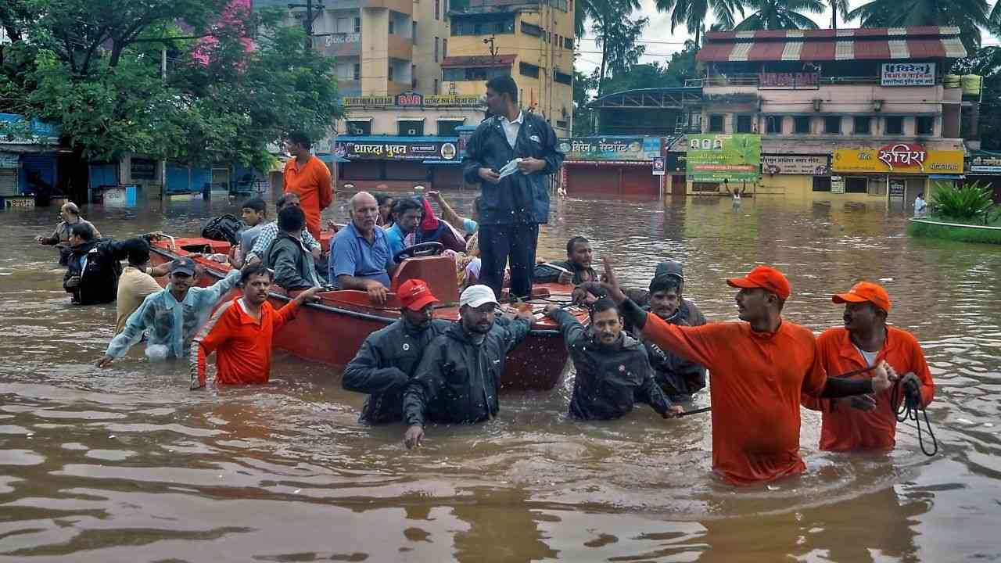
Motivation -
Among all disasters that occur in India, floods and drought are commonly occurs due to irregularity in monsoon.
Highest death reported due to floods and drought.
Need some solution to give prior indication of floods and drought.

Slide 4
introduction
Most common natural disaster in the India.
May be caused due to rainfall.

Slide 5
Problem statement –
Disaster prevention and prediction, Flood prediction using machine learning approach.

Slide 6
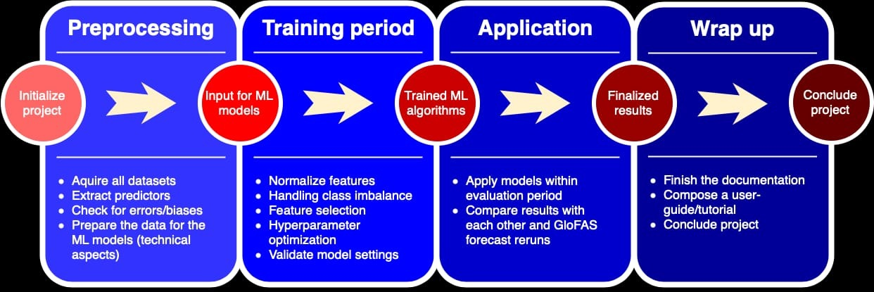
Project description
We plan to investigate various machine learning techniques for predicting the floods. The main goal is a comparative study of some of the most promising ML methods on this proposed subject.
Our projected workflow can be seen below:

Slide 7
Prediction of floods using ml
A dataset with the amount of rainfall and if a flood had occurred in a particular subdivisions, in the previous years, will be used. The dataset will have the rainfall data for a duration of 12 months.
Using this dataset, we take average rainfall of subdivisions of Maharashtra and Goa state and plot it on a graph to visualize it.

Slide 8
Algorithm to predict disaster -
We have used Machine Learning Algorithms to predict the probability of flood in that subdivision.
We take this average data of rainfall, as input to our machine learning model and if it causes a flood or not as the output labels. We train our model and save it.
We give this data as an input, and let the model predict, if whether there is a possibility of flooding or not. Our basic approach for this problem is binary classification, using basic machine learning algorithms.

Slide 9
Input file from user –
SUBDIVISION | YEAR | JAN | FEB | MAR | APR | MAY | JUN | JUL | AUG | SEP | OCT | NOV | DEC

Slide 10
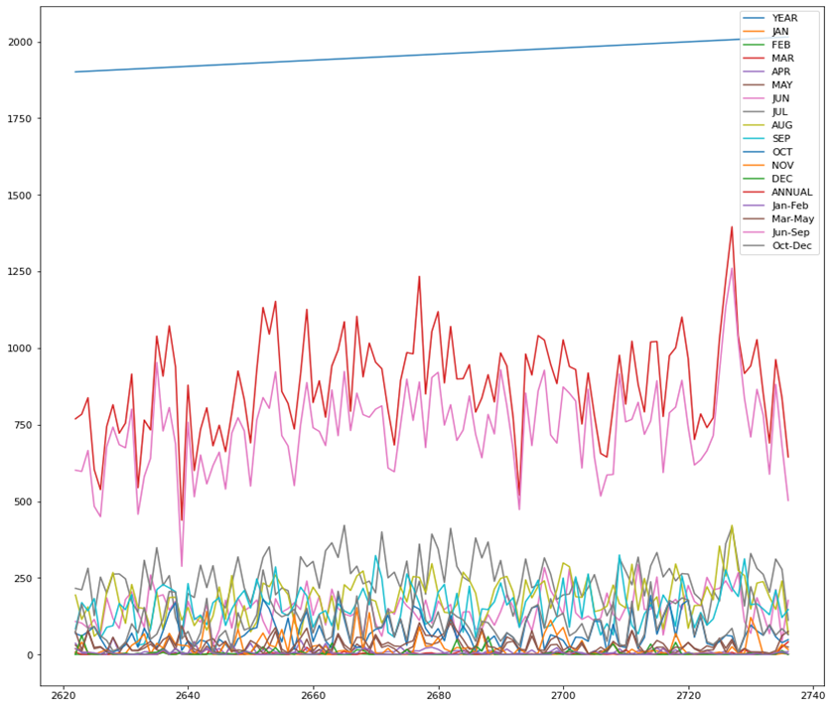
Results –
Graph Showing the trend of rainfall in Madhya Maharashtra.

Slide 11
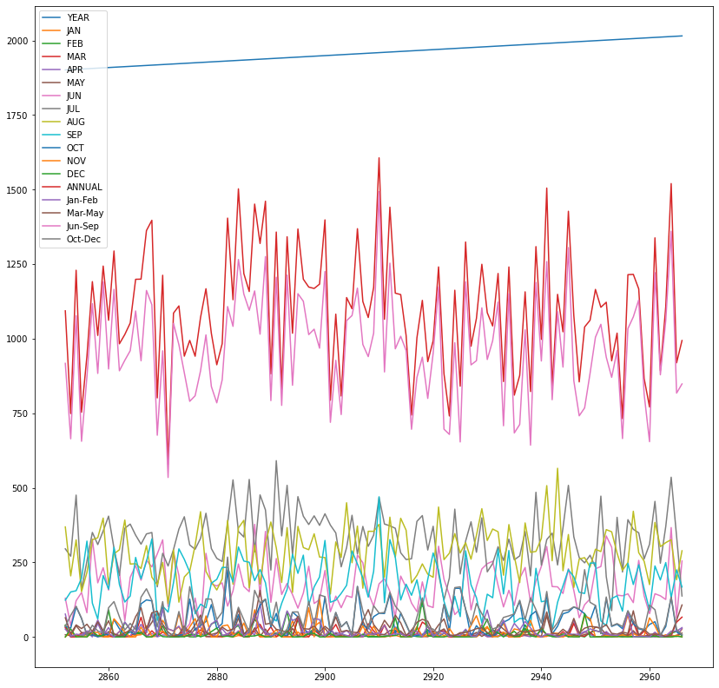
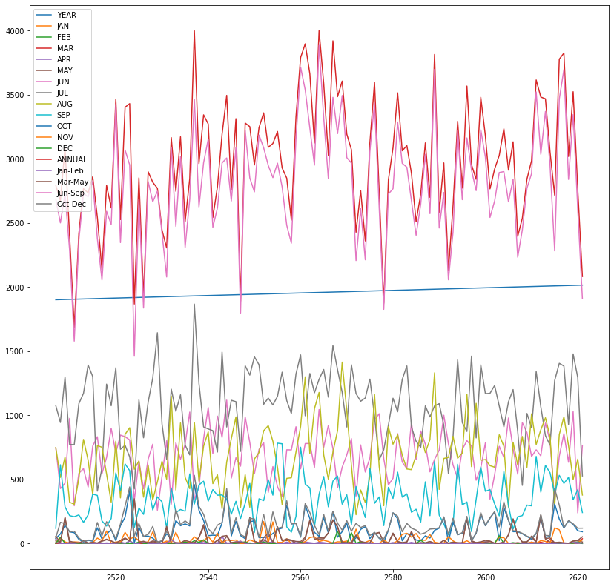
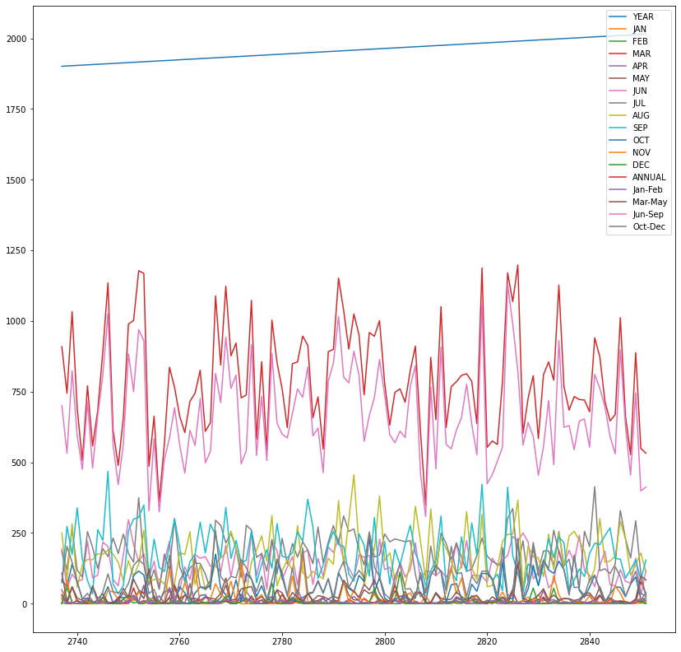
Graph showing the trend of rainfall in Vidarbha, Konkan & Goa, Marathwada.

Slide 12
Models used to predict floods -
Support vector machine (SVM)
Random forest
Multilinear regression model
MLP Regressor

Slide 13
Prediction of models
Support vector machine
Random forest
0.34
0.51

Slide 14
Multilinear regression model
Mlp Regressor
0.5509
0.5513

Slide 15
Thank you

